Slide 1

Web Scraping
Andrew Beatty
Andrew.Beatty@gmit.ie
Data Representation

Slide 2

This lecture
Reading web pages with Request
Reading last weeks html file
Using BeatifulSoup4 to go through the html
Searching down (and up) the Dom tree
Saving content in a CSV file
The dark art of web sraping

Slide 3

Getting content into program
Request module
import requests
page = requests.get("http://dataquestio.github.io/web-scraping-pages/simple.html")
print (page)
print("-------------------")
print (page.content)

Slide 4
Use BeautifulSoup to prettify
BeautifulSoup4 is a python package for navigating HTML and XML Dom trees
It uses other html/XML parsers (see later)
import requests
from bs4 import BeautifulSoup
page = requests.get("http://dataquestio.github.io/web-scraping-pages/simple.html")
soup1 = BeautifulSoup(page.content, 'html.parser')
print("-------------------")
print (soup1.prettify())

Slide 5
Parsers
Parser | Typical usage | Advantages | Disadvantages
html.parser | BeautifulSoup(markup, "html.parser") | Decent speed • Lenient (as of Python 2.7.3 and 3.2.) | • Not very lenient (before Python 2.7.3 or 3.2.2)
lxml’s HTML parser | BeautifulSoup(markup, "lxml") | • Very fast • Lenient | • External C dependency
lxml’s XML parser | BeautifulSoup(markup, "lxml-xml") | • Very fast • The only currently supported XML parser | • External C dependency
html5lib | BeautifulSoup(markup, "html5lib") | • Extremely lenient • Parses pages the same way a web browser does • Creates valid HTML5 | • Very slow • External Python dependency

Slide 6
Read in from a file
I assume that you have covered reading from files before.
This just opens a file and sends its contents to BeautifulSoup
Beautiful soup parses the file and strores a Dom tree in memory
from bs4 import BeautifulSoup
with open("../week02/carviewer2.html") as fp:
soup = BeautifulSoup(fp,'html.parser')
print (soup.prettify())

Slide 7
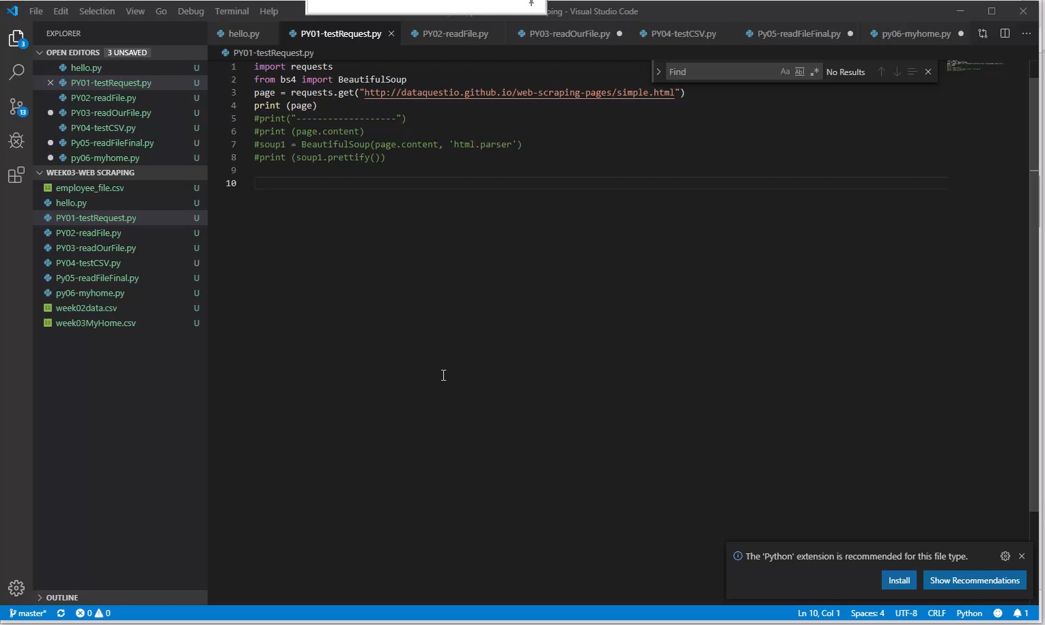

Slide 8
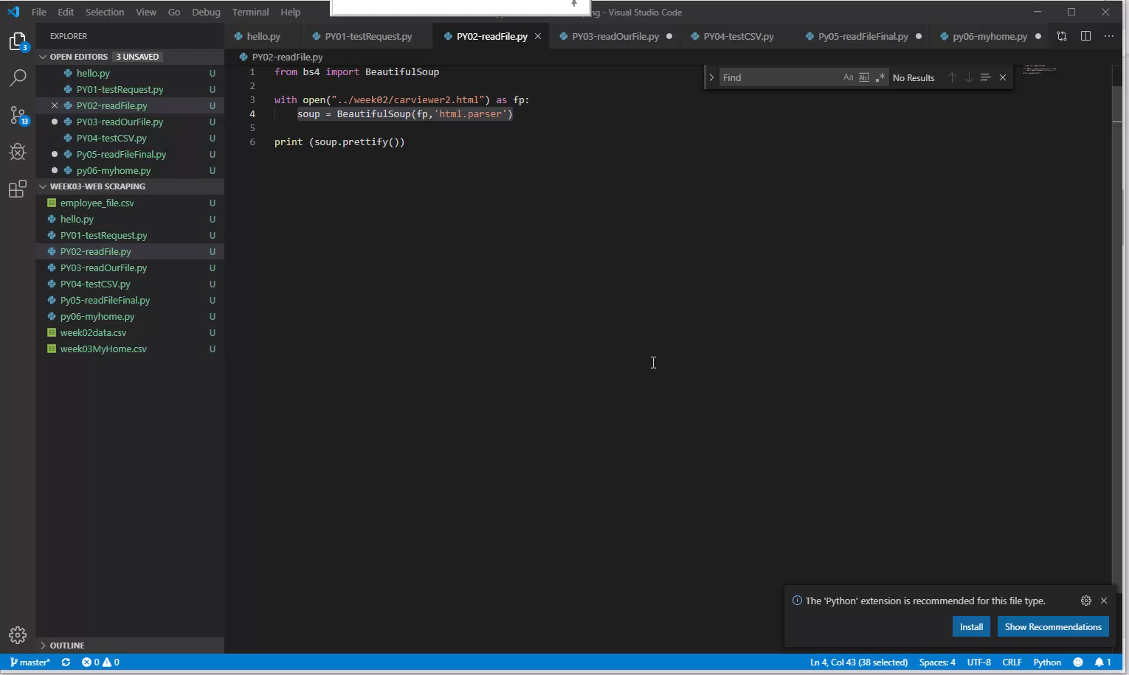

Slide 9
To search the Dom Tree
For any element .tagname will find the first occurance of it
You can use find() this will allow you to find the first element by id and/or class
You can use findAll to return a list of elements that match the search criteria
aElement = someElement.find(id=“someID”)
aElement = someElement.find(class_=“aClass”)
aElement = someElement.find(div, class_=“aClass”)
listOfElements = someElement.findAll(tr, class_=“aClass”)

Slide 10
Navigate the DOM Tree
.children
.parent
.parents (a list of parents)

Slide 11
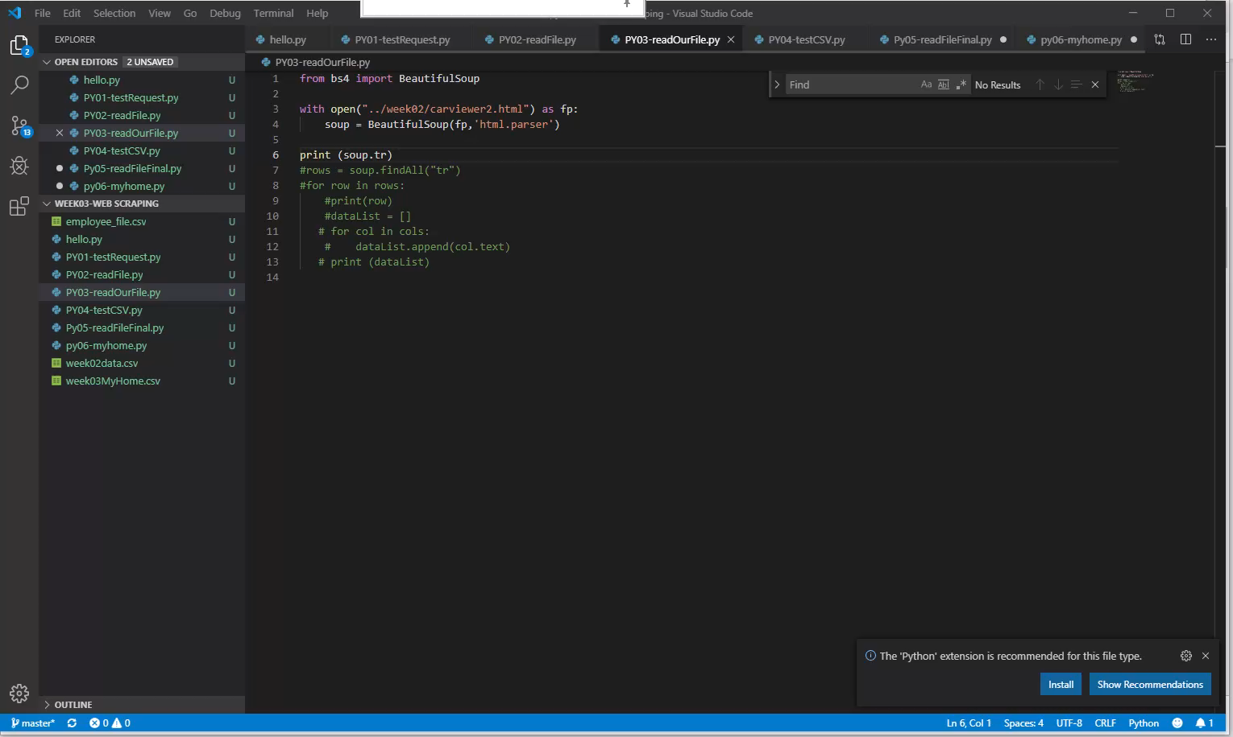

Slide 12
Using CSV package
Write to a CSV (Comma Deliminated File)
You can read a CSV with Excel
We could create an Excel file in Python, maybe later
We will use \t (tab) later
import csv
employee_file = open('employee_file.csv', mode='w')
employee_writer = csv.writer(employee_file, delimiter=',', quotechar='"', quoting=csv.QUOTE_MINIMAL)
employee_writer.writerow(['John Smith', 'Accounting', 'November'])
employee_writer.writerow(['Erica Meyers', 'IT', 'March'])
employee_file.close()

Slide 13
